Slide 1
Dimensionality Reduction
PCA, KPCA, Metrics for clustering

Slide 2
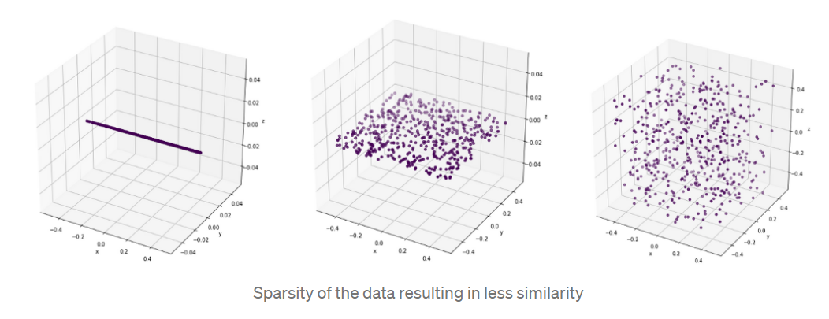
Dimensionality reduction is the process of reducing the number of random variables or attributes under consideration.
When the dimension increases, with the sparsity, the distance between two independent points increases. That results in less similarity among the data points which will result in more error when it comes to most of the machine learning and other techniques used in data mining. To compensate we will have to feed very large number of data points but with higher dimensions it’s practically impossible and even it’s possible it will be inefficient.

Slide 3
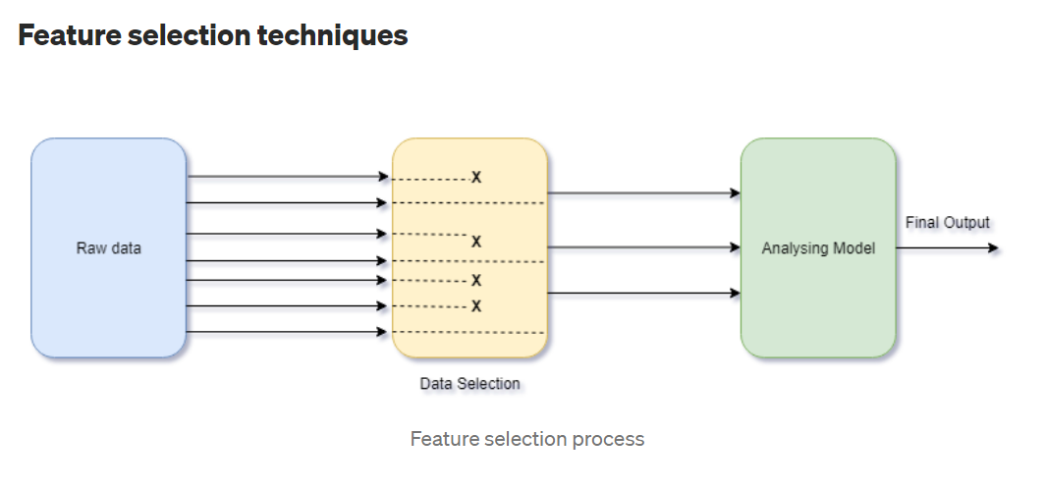
Techniques of dimensionality reduction
Dimensionality reduction is accomplished based on either feature selection or feature extraction.
Feature selection is based on omitting those features from the available measurements which do not contribute to class separability. In other words, redundant and irrelevant features are ignored.

Slide 4
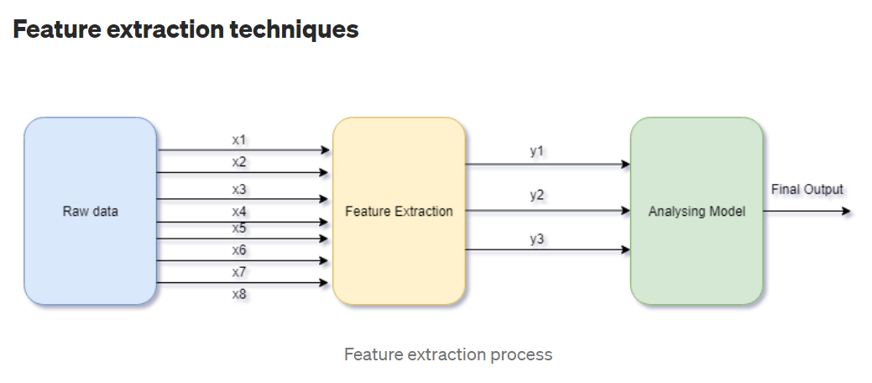
Feature extraction, on the other hand, considers the whole information content and maps the useful information content into a lower dimensional feature space.

Slide 5
Why Dimensionality Reduction is Important
Dimensionality reduction brings many advantages to your machine learning data, including:
Fewer features mean less complexity
You will need less storage space because you have fewer data
Fewer features require less computation time
Model accuracy improves due to less misleading data
Algorithms train faster thanks to fewer data
Reducing the data set’s feature dimensions helps visualize the data faster
It removes noise and redundant features

Slide 6
Dimensionality Reduction Techniques
Here are some techniques machine learning professionals use.
Principal Component Analysis(feature extraction).
PCA extracts a new set of variables from an existing, more extensive set. The new set is called “principal components.”
Backward Feature Elimination.
Forward Feature Selection.
Low Variance Filter.
High Correlation Filter.
Decision Trees.(feature selection)
Random Forest.
Factor Analysis.(feature selection)

Slide 7
How do you do a PCA?
Standardize the range of continuous initial variables
Compute the covariance matrix to identify correlations
Compute the eigenvectors and eigenvalues of the covariance matrix to identify the principal components
Create a feature vector to decide which principal components to keep
Recast the data along the principal components axes

Slide 8
General PCA rule
Compute covariance matrix
Find eigenvalues and eigenvectors
Sort eigenvalues (largest → smallest)
Choose eigenvectors corresponding to the largest eigenvalues
We choose the eigenvector with the largest eigenvalue because it captures the maximum variance (information) in the data.
In PCA:
Eigenvalue (λ) → amount of variance captured in that direction
Eigenvector (v) → direction of that variance

Slide 9
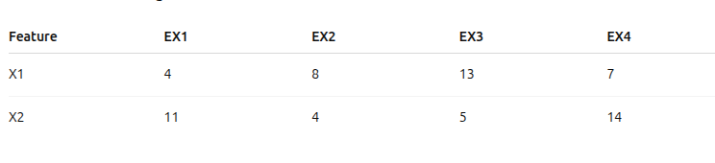
(4,11),(8,4),(13,5),(7,14)

Slide 10
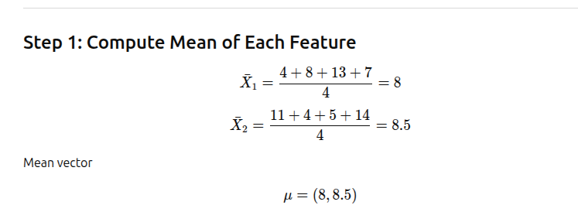

Slide 11
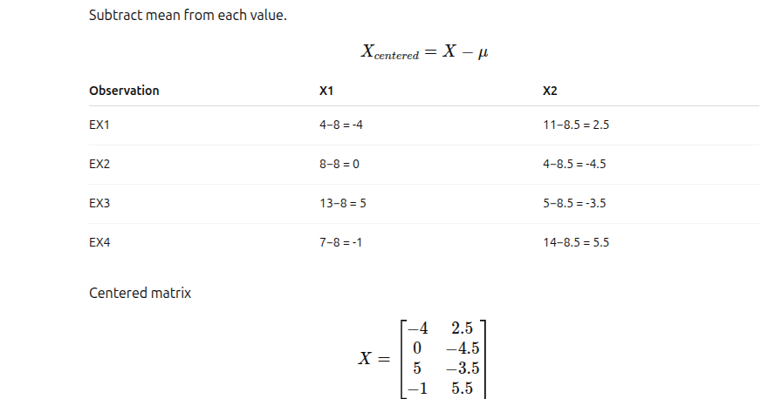
Step 2: center the data

Slide 12
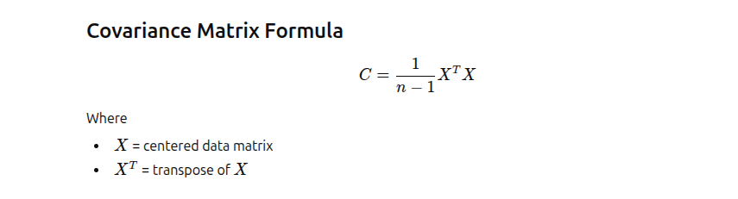
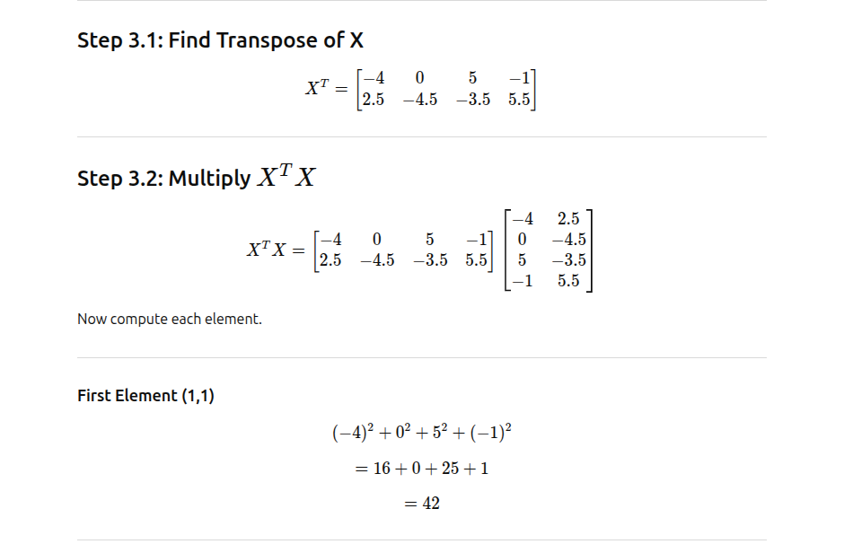
Step 3:

Slide 13
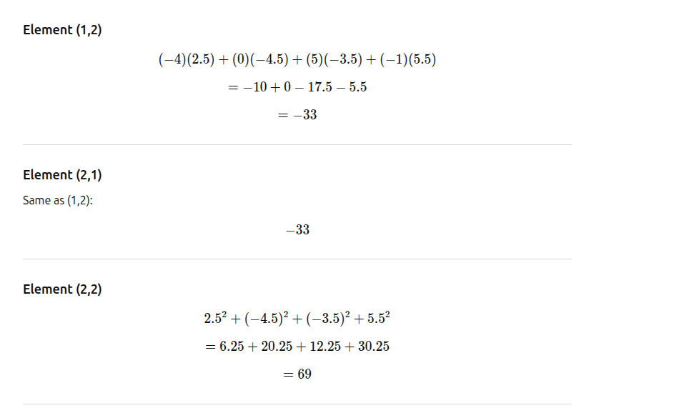

Slide 14
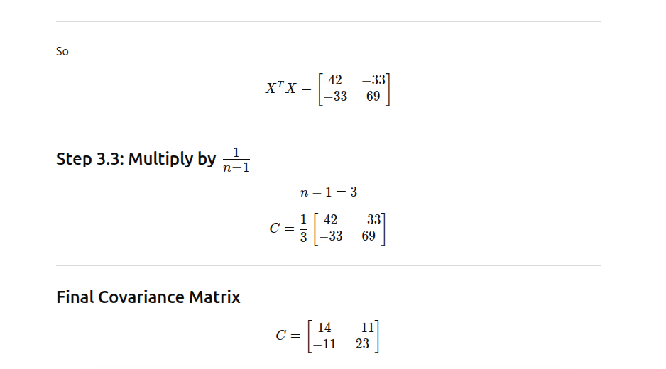

Slide 15


Slide 16
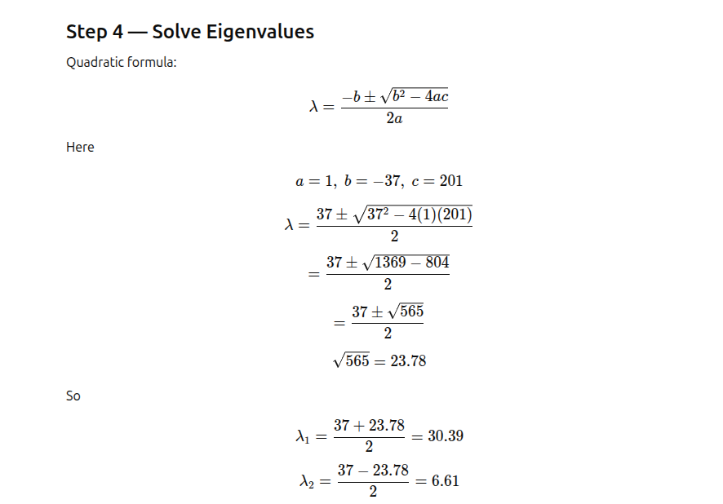

Slide 17
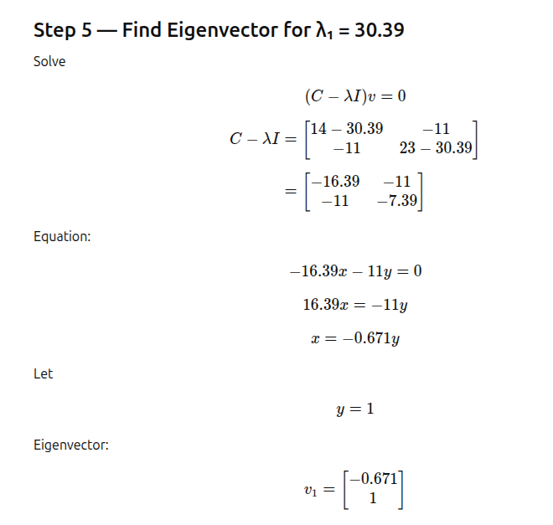


Slide 18
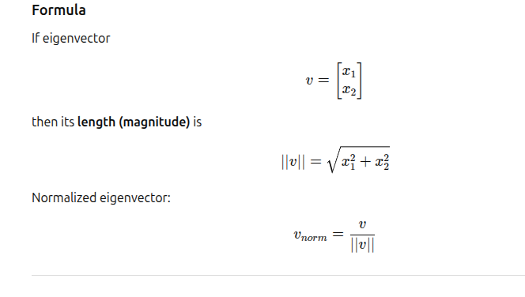

Slide 19
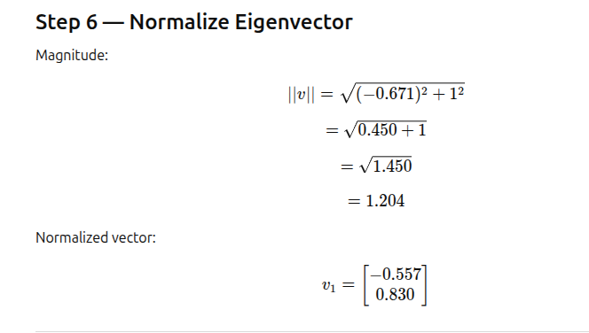
PC1 = [−0.557, 0.830]

Slide 20
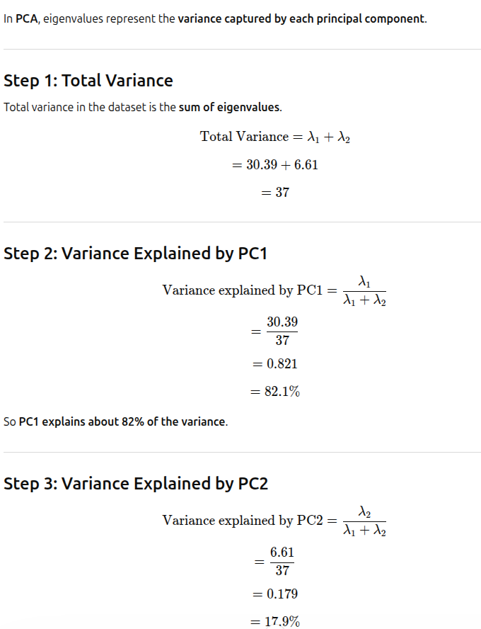

Slide 21
Advantages
Reduces dimensionality
Removes multicollinearity
Faster training
Useful for visualization
Limitations
Only linear relationships
Hard to interpret new components
Sensitive to scaling

Slide 22
Kernel PCA (KPCA)
PCA is a linear method. That is it can only be applied to datasets which are linearly separable. But, if we use it to non-linear datasets, we might get a result which may not be the optimal dimensionality reduction.
Kernel PCA uses a kernel function to project dataset into a higher dimensional feature space, where it is linearly separable. It is similar to the idea of Support Vector Machines. There are various kernel methods like linear, polynomial, and gaussian.
Kernel Principal Component Analysis (KPCA) is a technique used in machine learning for nonlinear dimensionality reduction.
It is an extension of the classical Principal Component Analysis (PCA) algorithm, which is a linear method that identifies the most significant features or components of a dataset. KPCA applies a nonlinear mapping function to the data before applying PCA, allowing it to capture more complex and nonlinear relationships between the data points.
In KPCA, a kernel function is used to map the input data to a high-dimensional feature space, where the nonlinear relationships between the data points can be more easily captured by linear methods such as PCA.
The principal components of the transformed data are then computed, which can be used for tasks such as data visualization, clustering, or classification.

Slide 23
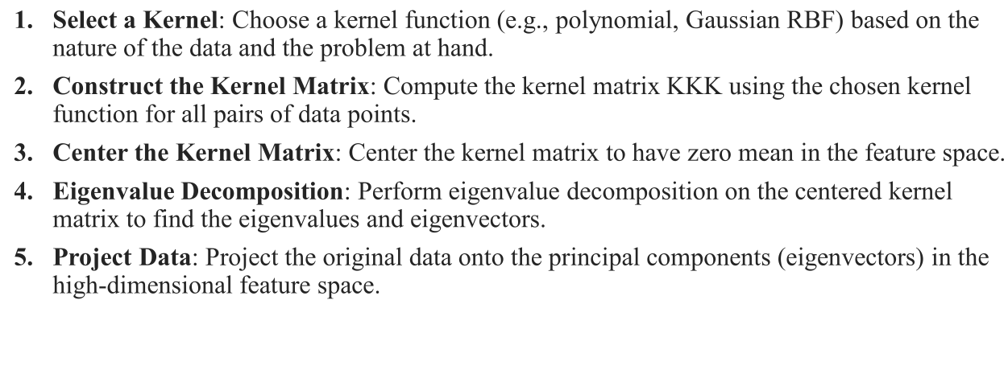
KPCA

Slide 24
Advantages
It can handle nonlinear relationships between the input features, which can be useful for tasks such as image or speech recognition.
KPCA can also handle high-dimensional datasets with many features by reducing the dimensionality of the data while preserving the most important information.
Limitations
KPCA has some limitations, such as the need to choose an appropriate kernel function and its corresponding parameters, which can be difficult and time-consuming.
KPCA can also be computationally expensive for large datasets, as it requires the computation of the kernel matrix for all pairs of data points.

Slide 25
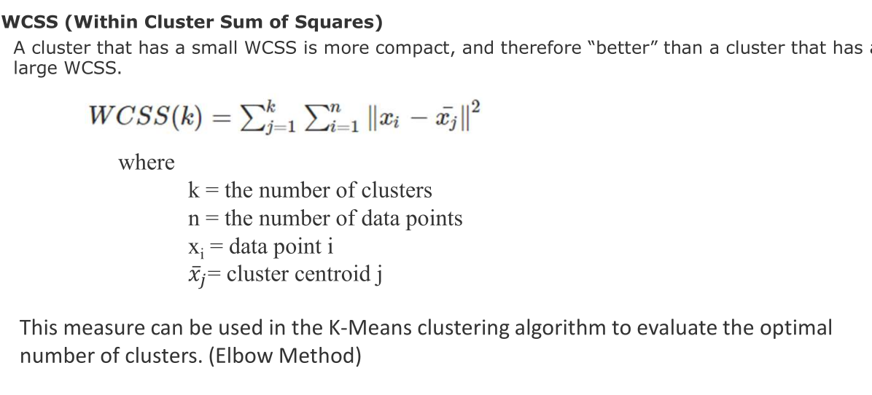
Metrics for unsupervised learning-clustering

Slide 26
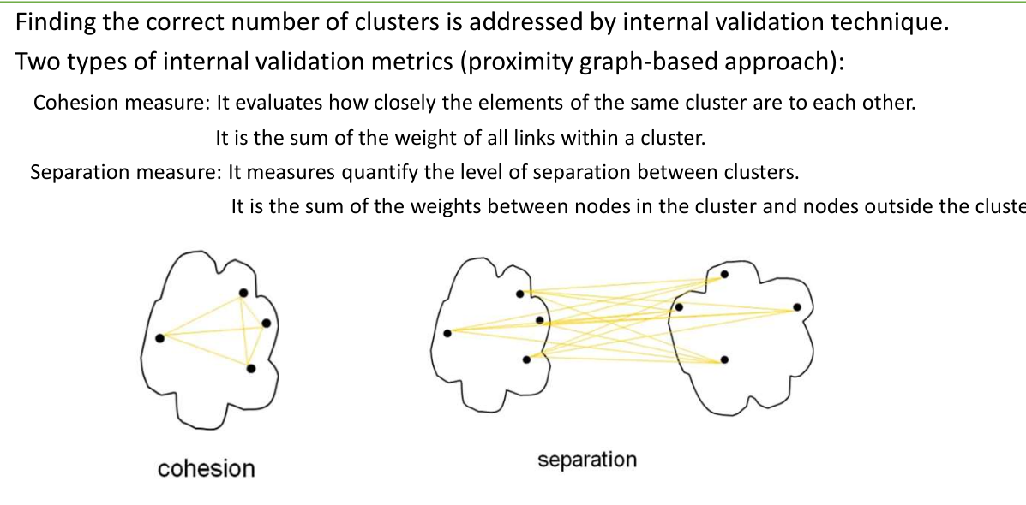

Slide 27
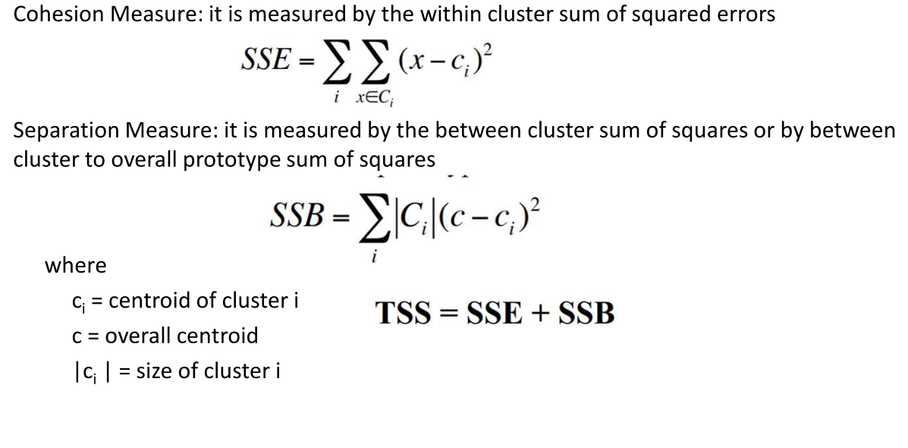

Slide 28
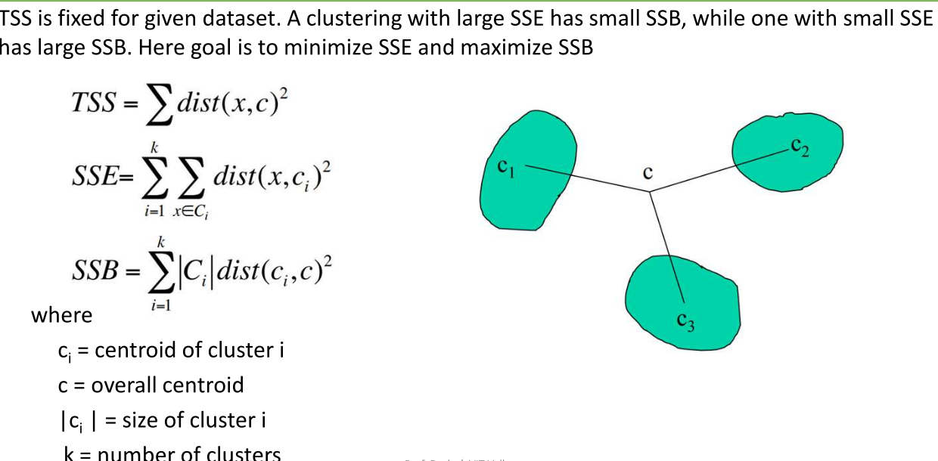

Slide 29
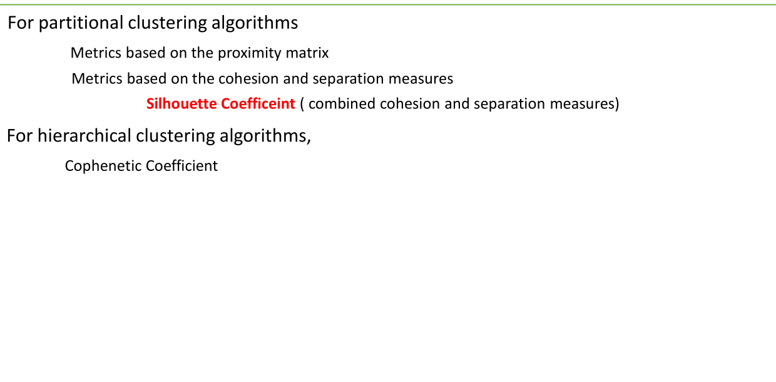

Slide 30
